Slide 1

THIRD EYE FOR THE BLIND
Review 1
Guide : Prof. ASISH KUMAR DALAI (department of cse)

Slide 2
TEAM DETAILS: BATCH:180272
1)TAHA JUNAID-18BCD7072
2)MOHAMMED TAQI UDDIN-18BCN7050
3)DARRAIN SAA-EYD -18BCN7009
4)SHOAEB-18BEC7067
5)KRISHNA-18MIS7233
6)MAHESH-18MIS7163

Slide 3
OBJECTIVE:
Third eye for people who are blind is an innovation which helps the blind people to navigate with speed and confidence by detecting the nearby obstacles using the help of ultrasonic waves and notify them with buzzer sound or vibration. They only need to wear this device as a band or cloth.
According to WHO 39 million peoples are estimated as blind worldwide. They are suffering a lot of hardship in their daily life. The affected ones have been using the traditional white cane for many years which although being effective, still has a lot of disadvantages. Another way is, having a pet animal such as a dog, but it is really expensive. So the aim of the project is to develop a cheap and more efficient way to help visually impaired to navigate with greater comfort, speed and confidence.

Slide 4
MAJOR ACTIVITIES PLAN TO MEET OUTCOME:
This is the first wearable technology for blind people which resolves all the problems of existing technologies. Now a days there are so many instruments and smart devices for visually impaired peoples for navigation but most of them have certain problems for carrying and the major drawbacks is those need a lot of training to use. The one of the main peculiarity of this innovation is, it is affordable for everyone, the total cost being less than $25 (~1500INR). There are no such devices available in the market that can be worn like a cloth and having such a low cost and simplicity. When used on a large scale, with improvements in the prototype, it will drastically benefit the community.

Slide 5
EXISTING SYSTEMS AND DRAWBACKS
White cane
Pet dog
Smart devices (eg : Vision a torch for blinds)
Problem of the Existing Systems:
White cane - May easily crack/break,the stick may get stuck at pavement cracks of different objects.
Pet dog - Huge cost. (~$42,000 / 280000Rs )
Common Disadvantages (Including the smart devices) Cannot be carried easily, needs a lot of training to use.

Slide 6
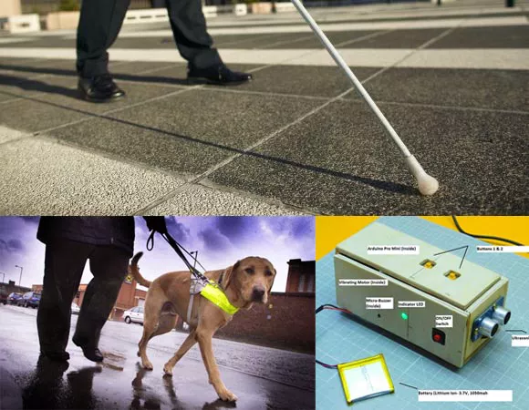

Slide 7
THINGS USED IN THIS PROJECT:
Arduino UNO
5 ultrasonic sensor
Perfboard
Vibrating motor
Buzzer
5mm led: RED
Switch sensor
Female header
Male header
Jumper wires
Power bank
C.H.I.P approved lipvo battery

Slide 8
PROPOSED MODEL WITH MERITS:
The features of Third eye for blind people: By wearing this device they can fully avoid the use of white cane and such other devices. This device will help the blind to navigate without holding a stick which is a bit annoying for them. They can simply wear it as a band or cloth and it can function very accurately and they only need a very little training to use it.
The entire project can be made in the form of jacket,so that the device doesn’t need to be wear one by one.

Slide 9
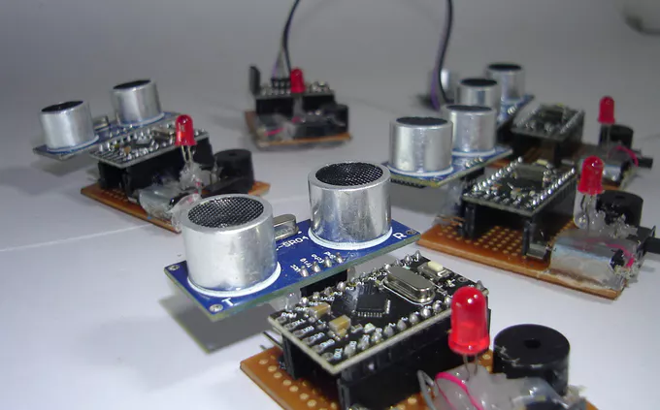
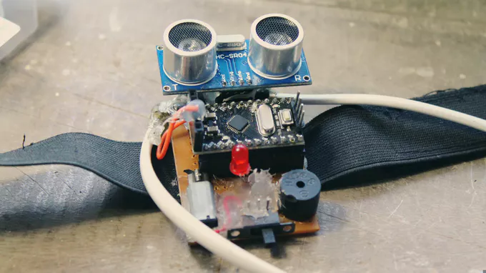

Slide 10
WHY THIRD EYE ? APPLICATIONS
The first wearable technology for people who are blind
Using ultrasonic waves to detect the obstacles
Notifying the user through vibrations/buzzer sound

Slide 11
TIME LINE CHART
Submission
Integration with IDE
Coding-Arduino IDE
Hardware Analysis
Pbm Identified
Literature Survey
Modules | Aug1-4 week | Sept 1st week | Sept 2nd week | Sept 3rd week | Sept 4th week | Oct 1st week | 2nd week | 3rd week | 4th week | Nov 1st week

Slide 12
REFERENCE:
https://www.robotechmaker.com/2016/11/third-eye-for-blind.html
www.google.com
www.Wikipedia.com

Slide 13
THANK YOU !!!!

